Slide 1
DATA
PREPROCESSING
Presented by
Geethu

Slide 2
Missing Value
Missing data is defined as the values or data that is not stored (or not present) for some variable/s in the given dataset. Missing values are common occurrence in data. Missing value will decrease model efficiency.it appears due to
• Past data might get corrupted due to improper maintenance.
• Observations are not recorded for certain fields due to some reasons
• User has not provided value intentionally

Slide 3
Data Preprocessing
Data preprocessing is a crucial step in machine learning and AI. It involves cleaning, transforming, and organizing raw data to prepare it for analysis.Preprocessing aims to ensure that the data is in a suitable format for machine learning models, enhancing their accuracy and effectiveness.

Slide 4
Data Cleaning
Data cleaning means fixing bad data in dataset. Bad data could be
Empty cells
Data in wrong format
Wrong data
Duplicates

Slide 5
Missing value Handling
Remove entire column or empty row using drop, dropna() method.
Replace empty values with specific value using fillna() method.
Mean,median,mode Imputation.

Slide 6
OneHot Encoding
Encoding is the process of converting categorical data into a numerical format that machine learning models can understand.
One Hot Encoding
for data has no inherent order
One hot encoding generates one column for every category and assigns a positive value (1) in whichever row that category is present, and 0 when it’s absent.

Slide 7
Label Encoding
it embeds values from 1 to n in an ordinal (sequential) manner. ‘n’ is the number of samples in the column.
This method is not recommended when the categorical values have no inherent order
it works well with ordered categories.

Slide 8
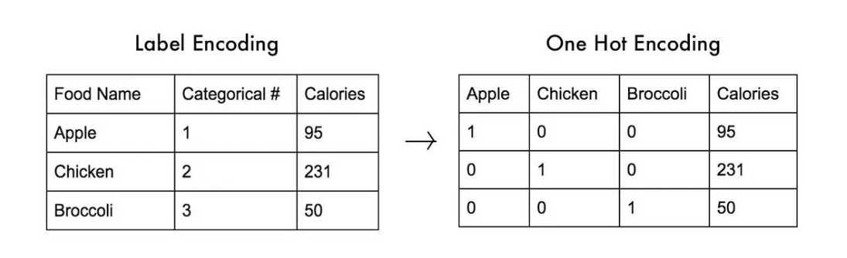

Slide 9
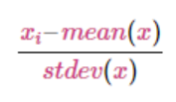
Scaling
Feature Scaling is a technique to standardize the independent features present in the data in a fixed range.
Standard Scalar
it assumes that the variable is normally distributed and then scales it down so that the standard deviation is 1 and the distribution is centered at 0.

Slide 10
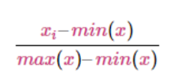
MinMax Scalar
min-max scaler shrinks the feature values between any range of choice. For example, between 0 and 5.

